Slide 1

Safer Roads in Breda
Team No.6
By Lars Kerkhofs, Natalia Mikes, Artjom Musaelans, Dominik Ptaszek, Luka Wieme

Slide 2
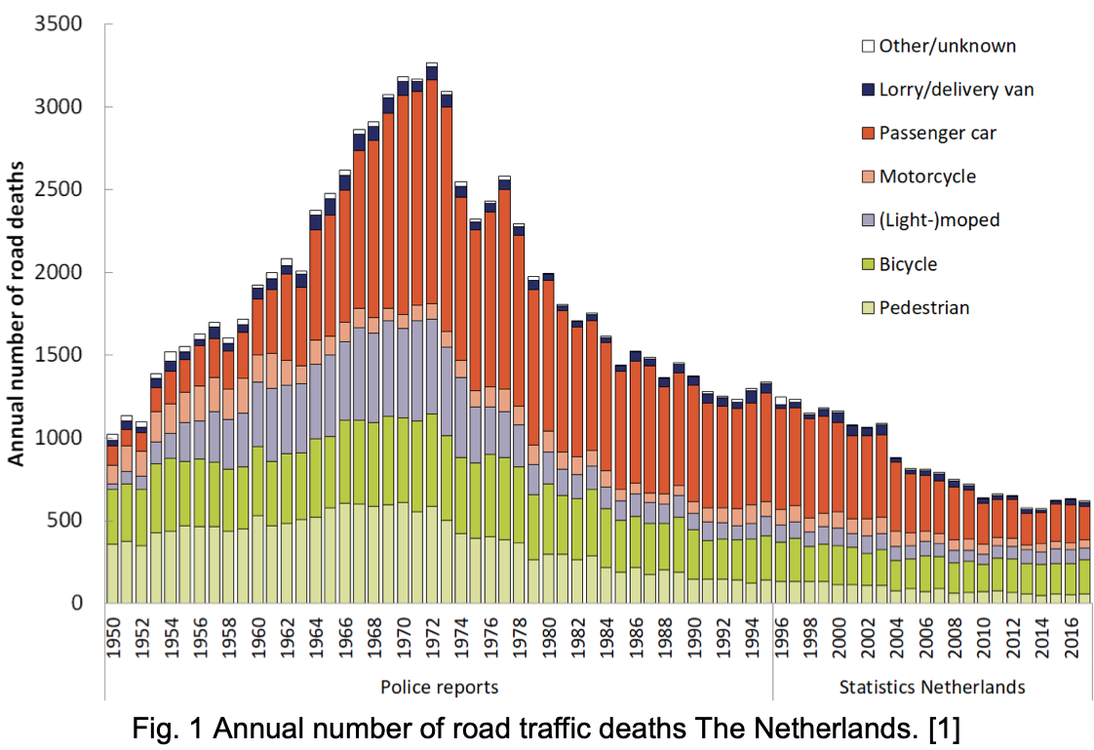

Introduction
ANWB's application: Onderweg en Wegenwacht (translation: En route and Roadside assistance).
Best App in 2023!
Purpose and Objective:
High-risk vs. Low-risk
Relevance
Machine Learning significance
(ANWB Onderweg & Wegenwacht - Apps Op Google Play, n.d.)
(Road Deaths - 9. How Has the Number of Road Deaths in the Netherlands Developed Since 1950?, n.d.)
Notes:
Content:
- Introduction (Dean, 5 min)
- Cognition/Data Management (Bram, 5 min)
- Computer Vision (Irene, 5/10 min)
- Robotics (Dean, 5/10 min)

Slide 3
Problem Statement
Defining the Problem:
Use machine learning to identify high-risk road locations in Breda, forecast road incidents, and provide actionable insights to improve road safety.
Context and Background:
Current situation: Breda faces road accidents, endangering drivers and incurring high costs for insurance companies.
Data: Access to the ANWB Safe Driving dataset and Breda-specific accident data for comprehensive analysis.
Challenges: Traditional methods are reactive and lack accuracy.
Importance and Benefits:
Enhanced road safety: Predict high-risk areas to alert drivers and reduce accidents.
Stakeholder advantages: Proactively address safety concerns, lowering incident costs and boosting public trust.
Economic impact: Fewer accidents lead to reduced insurance and repair costs, benefiting both insurers and clients.

Slide 4
Data Description
Our datasets:
ANWB – Safe Driving
KNMI – Weather
Some interesting variables:
category
road_name
RI_REGENM_10
dtg

Slide 5
Data Description
Data preprocessing steps:
Data cleaning
Missing values
Duplicates
Data transformation
Encoding categorial functions
Joining datasets
Data formatting

Slide 6
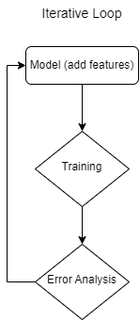
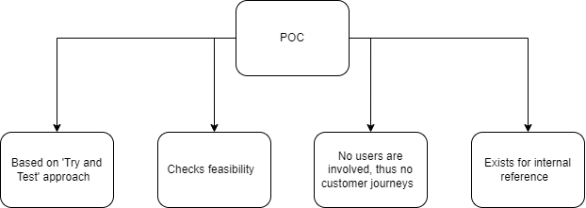
Methodology
How the project's identified problem will be solved:
Our team will introduce an iterative process of development
Feasibility of our project will be thoroughly checked with POC (Proof-Of-Concept Model)

Slide 7
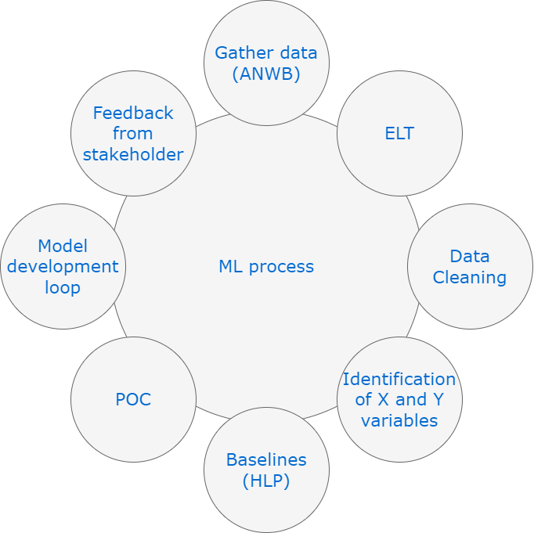
Methodology
Steps involved in the machine learning process:
Our team has clear path of project development
Our current assumptions of what to use :
Impute missing data using ML models
Handle skewed data distribution
Data augmentation if possible and reliable
Ensuring fairness by excluding sensitive information
To use LSTM, GRU
RMSE as success metric
Notes:
Explain why you chose these models and how they are suitable for addressing the problem?:Why LSTM (Long Short-term memory ) or GRU (Gated Recurrent Unit ) ? These models are suitable for problems associated with time-series. Since in our case we care about the order of the data and time directly affects data points, it is only logical to use the models which take that into the account.
Moreover, LSTM is based on recurrent network which is not constrained and can accept various amount of input values. Therefore, we can adjust of how many days we provide the data to the model which provides great flexibility. On top of that, every time the new input is accepted to the model, the previous transformed input value is used to calculate a new output value. All things considered, these models which are often times used in stocks, are very popular and accurate in predicting future values based on past.

Slide 8
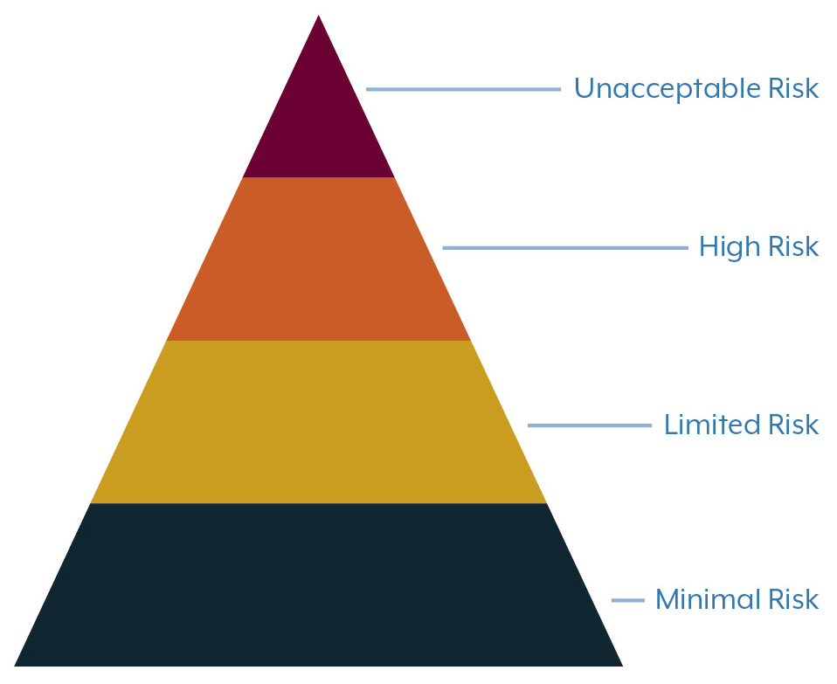
Methodology
Project's risk level: High
Why?
Legal obligations:
Compliance with Title III of the EU AI Act, which covers high-risk AI systems, is mandatory.( European Parliament, 2021)
Additionally, adherence to the General Data Protection Regulation (GDPR) is required due to the processing of personal data (European Parliament, 2016).
(McElligott, n.d.)
Notes:
Explain the level of risk associated with the intended AI system.
The AI system leverages driving and weather data to predict accident probabilities, impacting public safety significantly. Such systems are categorized as high-risk under the EU AI Act, especially when they influence decisions related to personal safety
Provide a list of associated legal obligations that must be followed and explain your approach for addressing them.
Legal obligations:
Compliance with Title III of the EU AI Act, which covers high-risk AI systems, is mandatory.
Additionally, adherence to the General Data Protection Regulation (GDPR) is required due to the processing of personal data (European Parliament, 2016; European Parliament, 2021).

Slide 9
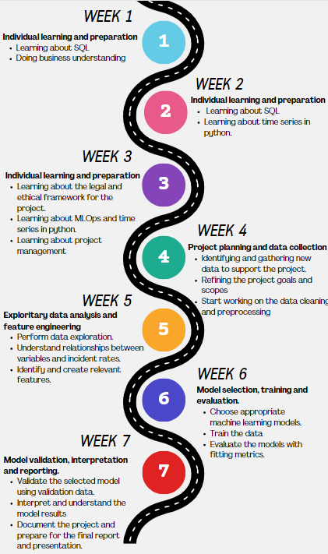
Project Timeline
Contributions of each team member:
Luka: Data analyst
Dominik: Data engineer #1
Lars: Data engineer #2
Natalia: Business understanding
Artjom: Data scientist

Slide 10
References
anwb.nl
McElligott, B. (n.d.). Risk Categories EU AI Act. mhc.ie. https://www.mhc.ie/hubs/the-eu-artificial-intelligence-act/eu-ai-act-risk-categories
European Parliament. (2016). Regulation (EU) 2016/679 of the European Parliament and of the Council of 27 April 2016 on the protection of natural persons with regard to the processing of personal data and on the free movement of such data (General Data Protection Regulation). https://eur-lex.europa.eu/eli/reg/2016/679/oj
European Parliament. (2021). Regulation on Artificial Intelligence – The first-ever legal framework on AI. https://digital-strategy.ec.europa.eu/en/policies/regulatory-framework-ai
Road deaths - 9. How has the number of road deaths in the Netherlands developed since 1950? (n.d.). https://swov.nl/en/fact/road-deaths-9-how-has-number-road-deaths-netherlands-developed-1950
ANWB Onderweg & Wegenwacht - Apps op Google Play. (n.d.). https://play.google.com/store/apps/details?id=com.themobilecompany.Onderweg&hl=nl&pli=1

Slide 11


Thank you for your attention!

